Slide 1
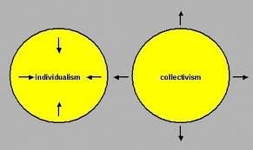
Chapter 2 – Ideologies of Individualism and Collectivism
Unit One – Should Ideology be the foundation of identity?

Slide 2
Ideologies of Individualism & Collectivism
We cannot escape the fact that, as human beings, we are both individuals and part of a collective.
In previous chapters, you were introduced to the concepts of individualism and collectivism. When we examine ideologies, we can see that each of them is based on either individualism or collectivism, or a mixture of the two.
In this chapter you will explore several understandings of individualism and collectivism.

Slide 3
Individualist Ideologies
Individualist ideologies tend to advocate individual rights, and freedom from government and from collective controls and restrictions. They promote principles such as autonomy, self-interest, personal achievement, and self-reliance.

Slide 4
Collectivist Ideologies
Collectivist ideologies endorse the idea of working cooperatively to solve problems and manage economic and social issues. They hold that collective enterprises, unions, and teamwork can accomplish more than individuals and competition can. They stress social harmony and cohesion over competitiveness.
Collectivist ideologies see a positive role for government assistance and control in regard to the economy and social issues, whereas individualist ideologies usually see government as interfering and counterproductive.

Slide 5
We will examine...
1. the interaction of individualism and collectivism in society by considering how these two tendencies underlie different ideologies to varying degrees.
Can they be reconciled? Are they opposed to each other, or do they complement each other?
2. the impact of these dynamically linked tendencies on society as well as their influence on personal identity as you deliberate the Chapter Issue: To what extent are individualism and collectivism foundations of ideology?

Slide 6
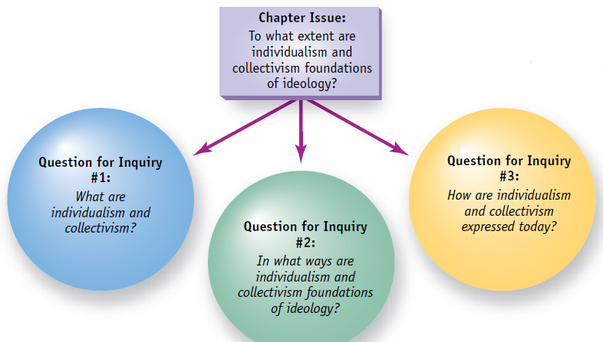

Slide 7
Section 1 – What is individualism & Collectivism
``One of the dominant characteristics of modern culture is individualism. This individualism prevails not only in the United States but elsewhere, including Korea. In view of such a long human history, it is not easy to define individualism because as a phenomenon it is complex and varied. According to Elwood Johnson, individualism can be defined as “any mode of thought based on the faith that any person may become in himself a prime cause; he may in fact, act his way out of his own history.” Similarly, Emil Brunner sees individualism as a “Robinson Crusoe affair” in which the individual is solely important considering his own personality. In this view, society is a coalescence of individuals.`` -Yung Suk Kim (theology professor at Virginia
Union University), The Roots of Individualism

Slide 8
Individualism
There are many different ideologies based on some degree of individualism, and they do not all agree on the best means of organizing society. Nonetheless, most individualistic ideologies have a similar understanding of the individual’s place in society and stress the importance of ideas such as personal autonomy—a state of individual freedom from outside authority—and self-reliance—the quality of being solely responsible for one’s own well-being.

Slide 9
Collectivism
Like individualism, collectivism is not a single ideology: many different ideologies are based on collectivist ideas, and these various ideologies may differ in their methods and ultimate goals. All of them, however, stress human interdependence and the importance of a collective, regardless of size, rather than the importance of the individual. The focus of collectivists is the community and society, although families can also exemplify collectivist principles by encouraging members to be responsible for one another rather than simply looking out for themselves. Collectivism emphasizes group goals and the common good over individual goals or individual gain.

Slide 10
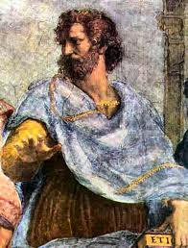
Early Understandings
Some of the principles of individualism have roots in ancient history.
The concept of self-interest was discussed in the 4th century BCE by the Greek philosopher Aristotle in his Politics: “That which is common to the greatest number has the least care bestowed upon it. Every one thinks chiefly of his own, hardly at all of the common interest; and only when he is himself concerned as an individual.” Other principles of individualism, such as individual rights and freedoms, have become widely accepted only more recently in history.

Slide 11
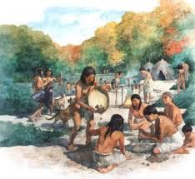
Early Understandings
Examples of collectivism can also be found in ancient cultures. Anthropological studies tell us that most, if not all, the earliest human societies were collectivist, because it was possible to survive only by working and hunting as part of a group. The sense of identity of ancient societies was largely based on membership in a group—usually an extended family.

Slide 12
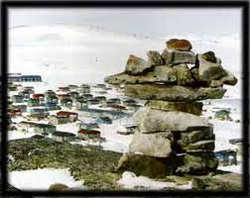
An Aboriginal Understanding of Collectivism
Indigenous peoples such as the Aboriginal peoples in Canada describe their traditional cultures as having a strong sense of the collective. In matters such as land-holding, decision making, and educating and raising children, many Aboriginal cultures emphasize thinking and acting collectively to achieve what is best for the common good. Many of these collectivist traditions are still practised in some Aboriginal communities.

Slide 13
Early Understandings
Inuit Elder Mary Anulik Kutsiq describes some of the collectivist aspects of life in traditional Inuit communities—and how some of those traditions have been lost—in the following interview excerpts:
In earlier times, Inuit were very close. They had strong friendships and helped each other through hard times. Today, some people have so much while others have so little and do not bother to share at all. In the earlier days, people shared food even if they didn’t have much, as long as there was a little bit of extra food. Pieces of meat were cut up evenly and distributed among the whole community. Bread, bannock and tea were also evenly shared. If there was not enough tea to be divided up for each household, every bit of it was brewed together in a big pot so that everyone could have a cup… The problem today is that there are too many people in the communities and a lot of them are too self-centred and involved with their own problems to help others. Before this community had so many people, we were all very close and helped each other in times of need. As the population grows, so does the gap between people. We are no longer one big family. We are now separated and we each go our own way… -Mary Anulik Kutsiq, “An Elder Offers Advice.”

Slide 14
The Medieval Period (circa 476 to the Renaissance)
Pax Romana, the “Peace of Rome”, which had provided structure and security throughout the empire, was replaced by lawlessness and unpredictability. With the collapse of the Roman Empire in 476 CE, Europe was thrown into chaos. Over time, order was restored in small areas under the guidance of local warlords. Small pockets of structure eventually grew into larger and larger areas as warlords joined together and an aristocracy was established.
Common people were provided structure and physical security in exchange for loyalty and service to their lords. But the individual life had very little worth. The common person was worth little more than the shrub or the cow on the land owned by the lord.

Slide 15
The Medieval Period
By 800 CE(Chrisitan Era), most of Europe had converted to Christianity under the Roman Catholic Church. The people of the various European kingdoms became subjects of two kingdoms—the worldly kingdom and the spiritual kingdom.
Security and order were provided by the earthly rulers. More important, however, was the security and promise provided by the spiritual rulers. If life here on earth was miserable, then at least life after death promised to be glorious.

Slide 16
The Medieval Period
The spiritual ruler—the Roman Catholic Church—held immense power as the gatekeeper of heaven.
One result of this situation was that people focused less on the things of the material world and more on the afterlife. Therefore developments in art, science, commerce, and progress in general were not emphasized, and the individual life here on earth mattered very little.

Slide 17
The Medieval Period
During the medieval period most people in Europe fit into distinct social categories—peasants, traders, craftsmen, clergy (priests, monks, and other people who performed duties in the Roman Catholic Church), and nobles.
What mattered was how you fit into your group—not your individual identity.
For example, if you were lucky, your family might know a stone mason and pay him to take you on as an apprentice. You would work for your master without pay while you learned the craft, then become a journeyman (who could work for pay for any master stone mason), and finally become a craftsman if you were accepted into the guild of stone masons.

Slide 18
The Medieval Period
During this time, cathedrals were being built all over Europe.
These huge building projects, spanning decades and even centuries, would employ many different craftsmen over the years.
However, the individual craftsmen were unnamed and received no fame or glory.

Slide 19
The Renaissance (circa 1450–1600)
In contrast to the medieval period, the Renaissance in Europe brought a greater interest in the individual. The term Renaissance comes from French and means “rebirth”.
This period in European history was characterized by a renewed interest in classical Greek and Roman culture. European scholars revived classical ideas about the central importance of life in this world, man’s central role in the world, and the appreciation of the worth of the individual.

Slide 20
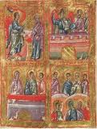
In 1453, Constantinople, capital of the Byzantine Empire, fell to the Ottoman Empire.
Many scholars from cities such as Constantinople fled west, taking with them many Greek manuscripts.
Islamic societies in Spain, North Africa, and West Asia had already been reading, translating, developing, and commenting upon Greek scholarship for many centuries, contributing to the growth of these ideas during the Renaissance.

Slide 21
Ancient Greece
Ancient Greek culture had been very humanistic and very individualistic.
These ideas took hold in the city-states of Italy and quickly changed the thinking and the focus of influential people in Europe.
Painters began to study nature and the world around them. They began to use perspective in their works, creating a more three-dimensional depiction of the real world and humans in that world.

Slide 22
The Renaissance
Sculptures such as Michelangelo’s Pietà, which depicts a religious scene, celebrated the individual human form. Also, individual artists became known: for example, the Pietà was seen as a great personal achievement for Michelangelo, who even carved his name on the sculpture.

Slide 23
Other works of art portrayed real individuals—patrons such as wealthy nobles, merchants, and craftsmen—instead of stylized and archetypical religious subjects. Many works also showed the growing importance of books, education, and the study of nature and natural forces.

Slide 24
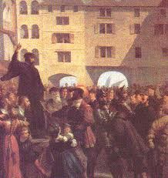
The Protestant Reformation (circa 1500–1650)
The Protestant Reformation, partially a product of the growing influence of the Renaissance focus on the potential of the individual in this world, also contributed to the growth of individualism by challenging the authority of the dominant Roman Catholic Church.

Slide 25
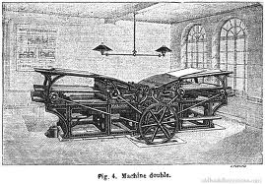
The Protestant Reformation (circa 1500–1650)
The Catholic Church interpreted religion for people through both Church tradition and the Bible, while many Protestant Churches claimed to rely on the Bible alone.
After the printing press was assembled around 1439, the Bible could be translated into many languages and distributed to many more people. In this way, people who could read began to explore, consider, and interpret their faith on a more personal level.

Slide 26
Collectivism & Individualism
The emergence of individualism in European societies was a process that took several centuries. And while individualism eventually came to predominate in many societies, it has never replaced collectivism entirely.
The two tendencies have existed side by side in a sometimes uneasy relationship that has shaped societies in the past and continues to shape societies today.

Slide 27
Peter Lougheed- The Greatest Albertan
http://www.edmontonjournal.com/news/Video+tribute+Peter+Lougheed/7242303/story.html
Alberta's P.C. party created this video tribute to Premier Peter Lougheed who died of natural causes on September 13, 2012 in Calgary. He was 84.

Slide 28
Quick Questions – September 18
What is autonomy?
What is self-reliance?
Was the medieval Period individualist or collectivist?
Was the Renaissance Period individualist or collectivist?
What was the Protestant Reformation?

Slide 29
Quick Questions – September 18
1. Autonomy is a state of individual freedom outside authority
Self reliance is the quality of being responsible for one’s own well-being.
collective
Individualist
Protestant Reformation was a time when the Protestant population influenced the Roman Catholics and convinced some to convert.

Slide 30
Section 2 Principles of Individualism and Collectivism-
Section 2 question: In what ways are individualism and collectivism foundations of ideology?
Yesterday we explored a general understanding of individualist versus collectivist ideas.
Today we will look at specific principles of individualism and collectivism on which various ideologies are based.

Slide 31
Principles of Individualism
Individualism is one possible foundation of ideology and is a foundation in particular of liberalism, the prevailing ideology in Western democracy.
In this section you will read about the different ways in which the following principles are manifested in society:
• rule of law
• individual rights and freedoms
• private property
• economic freedom
• self-interest
• competition

Slide 32
Rule of Law
The key principle in Canadian life—and in liberal democracies around the world—is the rule of law.
Essentially, every individual is equal before the law. Furthermore, this principle means that citizens are subject to clearly defined rules, rather than the arbitrary power of an individual or group in a position of authority.

Slide 33
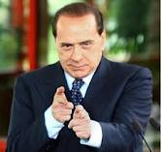
Rule of Law
For example, when Italian prime minister Silvio Berlusconi tried to use Italian immunity laws to avoid bribery charges, he was accused of trying to place himself above the law.

Slide 34
Individual Rights and Freedoms
Individual rights and freedoms are a key principle of individualism and an important feature of liberal democracies. Examples of such rights and freedoms include freedom of religion, freedom of association, and the right to life, liberty, and the security of the person.
One important individual right in liberal democracies is the right to vote.

Slide 35
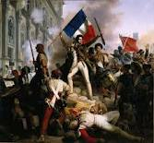
Individual Rights and Freedoms
Most early liberal democracies did not extend this right to all citizens. For example, after the American and French revolutions, the right to vote was granted only to some men, mainly property owners.

Slide 36
Examples of Voting Rights in History
In England, middle-class men got the vote only in 1832. Working-class men waited until 1885. English women were first able to vote only in 1919—and only if they were over the age of 30.
In France, all men received the right to vote for the first time in 1789. Various classes of men lost and regained this right until 1848, when all men in France gained the right to vote. Women were granted the right to vote in 1944.

Slide 37
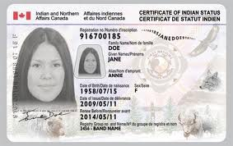
Examples of Voting Rights in History
In the early years of some states in the United States, voters had to be both male and Protestant.
During the apartheid era, South Africa restricted voting based on race. And Canada, for years, limited the right to vote for Aboriginal people identified as “status Indians.”
Only in 2004 did all prisoners in Canadian prisons become eligible to vote in federal elections

Slide 38
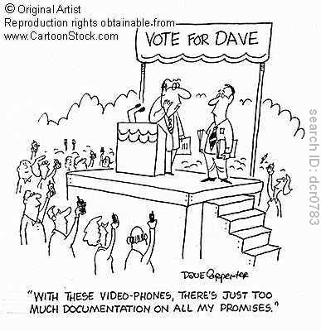
Voting Rights
Now, however, the right to vote has extended in most democratic countries to include all citizens above a certain age, usually 18 or 21.

Slide 39
Individual Rights and Freedoms
Guaranteeing individual rights and freedoms can have negative consequences in certain circumstances, and liberal democracies attempt to balance the rights of one individual against the rights of other individuals, the rights of groups, and the needs and goals of the society.
Therefore, we have laws that prohibit the promotion of hatred or discrimination, thus limiting freedom of expression.

Slide 40
For Example
In one extreme case, an Alberta high-school teacher named James Keegstra was dismissed from his teaching position in 1982 for expressing views in his classroom and claiming that the Holocaust did not happen.
Keegstra was eventually charged with unlawfully promoting hatred against an identifiable group.

Slide 41
Individual Rights and Freedoms
From the creation of Canada as a democracy, individual rights and freedoms have been expanded. In the 1960s, social mores were loosening, and this brought about many changes to laws and society in general.
Pierre Trudeau was asked in the late 1960s about legal changes (Bill C-150) that granted rights on the issues of sexual preference and reproductive choice. He answered,

Slide 42
Teudeau’s Response
Well, it’s certainly the most extensive revision of the Criminal Code since the new Criminal Code of [the] early 1950s…it’s bringing the laws of the land up to contemporary society, I think. Take this thing on homosexuality. I think the view we take here is that there’s no place for the state in the bedrooms of the nation, and I think that, you know, what’s done in private between adults doesn’t concern the Criminal Code. When it becomes public, this is a different matter.
—Pierre Elliott Trudeau, Minister of Justice (later Canadian prime minister)

Slide 43
Private Property
Modern understandings of property law developed during the Enlightenment period in England. At first, property law was understood to only apply to land (real estate), but it eventually came to apply to three types of property: real estate, other forms of physical possessions, and intellectual property (artistic works, inventions, and so on).
However, the notion of private property is only one way of looking at land and property; there are many different perspectives regarding the significance of people’s relationships with land

Slide 44
Private Property
For example, for some First Nations, Métis, and Inuit peoples, land reflects a person’s interrelationship with nature and all living things. Some peoples also believe that land cannot actually be owned—cannot be private property—but is rather shared. Some communities also have had a tradition of common property—shared by, worked by, and enjoyed by a
Such differences in perspective on land ownership have sometimes led to conflict among First Nations, Métis, and Inuit peoples, and between Aboriginal peoples and the British and Canadian governments.

Slide 45
Private Property Protection
The protection of private property can also be a source of conflict in the realm of intellectual property. For example, biotechnology companies expend large amounts of time and money developing and patenting new varieties of plants, such as drought-resistant wheat, that can benefit society as a whole. Farmers who grow these varieties pay royalties to the companies who own the patents. It is not always clear, however, whether newly created plant varieties are significantly different from the existing crops that have been grown for centuries.

Slide 46
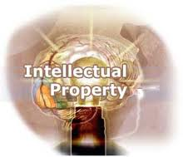
Intellectual Property Rights
Investigation page 15

Slide 47
Economic Freedom
On a personal level, economic freedom is the freedom to buy what you want and to sell your labour, idea, or product to whomever you wish.
Markets in which consumers and businesses have free choice to buy, sell, or trade, without government interference in those transactions, are called free markets.
Economic freedom for free-market entrepreneurs would mean that there were no barriers to trade for products they might want to export, and that their customers would not have to pay taxes on their purchases.

Slide 48
Economic Freedom
The Economic Freedom Index, compiled by the Wall Street Journal rates the economic freedom of 157 countries according to the following 10 factors:
• business freedom
• trade freedom
• fiscal (tax) freedom
• degree of government regulation
• monetary freedom
• investment freedom
• financial freedom
• property rights
• freedom from corruption
• labour freedom
In 2008, Canada was ranked 10th on this list!

Slide 49
Economic Freedom
The reason for its ranking is that Canada intervenes in its markets rather than leaving them free from government regulation.
After the Great Depression of the 1930s, Canada implemented policies designed to create a “social safety net” for Canadian:
the Unemployment Insurance Act (1940)
The Canada Pension Plan (1966)
The Medical Care Act (1966)and other acts transformed Canada into more of a welfare state.

Slide 50
Economic Freedom
A welfare state is one in which the economy is capitalist (free market), but the government uses policies that directly or indirectly modify the market forces in order to ensure economic stability and a basic standard of living for its citizens.

Slide 51
Self-Interest and Competition
Two concepts of individualism closely related to the principle of economic freedom are self-interest and competition.
Supporters of individualism see economic freedom as leading to the most efficient and beneficial economy for the greatest number of people, because it encourages competition and they assume that people generally act in their own self-interest.

Slide 52
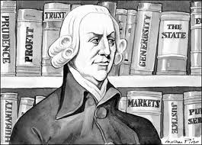
Self-Interest & Competition
These ideas were first promoted by 18th century Scottish philosopher and economist Adam Smith, who saw individual self-interest as an “invisible hand” that guides individuals to contribute for the common good of everyone.

Slide 53
Self-Interest and Competition
In this view, the forces of supply and demand in the marketplace work to the benefit of the majority. When there is too much supply of a product, the price drops and, eventually, so does the supply. When demand is greater than supply, the price of the product rises, and more entrepreneurs enter the marketplace to profit, eventually causing supply to meet demand once again.

Slide 54
QQ, Wednesday September 19
What is rule of law?
Where can you find your individual rights and freedoms as a Canadian citizen?
What are the 3 subcategories of private property?
What is economic freedom?
What is a welfare state?

Slide 55
QQ, Wednesday
Rule of law means every individual is equal before the law
The Charter of Rights and Freedoms document
Real Estate, physical possessions and intellectual possessions
Economic freedom is the freedom to buy what you want and to sell your labour, idea, or product to whomever you wish.
A welfare state is one in which the economy is capitalist (free market)

Slide 56
Principles of Collectivism
The principles of collectivism are the foundation of ideologies such as communism and socialism (resources controlled by the public)
While the principles of individualism formed the basis of the classical liberal ideology that originally guided modern democracies.

Slide 57
Principles of Collectivism
The principles of collectivism you will explore are:
• economic equality
• co-operation
• public property
• collective interest
• collective responsibility
• adherence to collective norms

Slide 58
Economic Equality
While Economic Equality is a principle of Collectivism, it’s meaning differs from one ideology to the next. It can mean any of the following:
• People with larger incomes should pay more taxes.
• All people should earn equal wages for work of similar value.
• There should be a guaranteed annual income (GAI).
• All people should share in the wealth of the country or the
world.
• People should own the means of production (factories or
companies that produce goods) collectively.
• Everything should be free. There should be no private property.

Slide 59
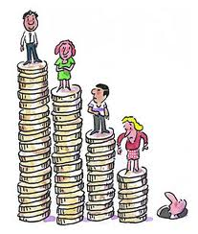
Economic Equality
Many countries have tried to reform their economic systems to introduce more economic equality.
In Canada, for example, the policy of progressive taxation could be seen as an attempt to redistribute wealth.
Progressive taxation means that people who earn more money are taxed at a higher rate

Slide 60
Economic Equality
Some thinkers have proposed that amounts of money are not at the heart of economic equality.
Ghandi believed, “Economic equality of my conception does not mean that everyone will literally have the same amount. It simply means that everybody should have enough for his or her needs…The real meaning of economic equality is “To each according to his need.”
Do you think we need more economic equality? If so, then perhaps the NHL lockout wouldn’t be happening right now!

Slide 61
Co-operation
All collectivist ideologies emphasize co-operation, a principle you are probably already very familiar with.
Co-operation can be beneficial to individuals and groups because individuals are unique and have different ideas about how to do things.
Co-operation is the means through which members of a group or a collective achieve their common goals.
It may involve designating roles, following certain protocols for speaking, or following guidelines for decision making.

Slide 62
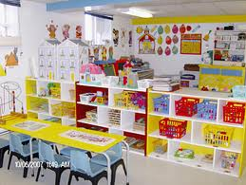
Co-operatives
One example of collective co-operation is a co-operative. Daycare centres, health-care centres, stores, and credit unions are a few examples of enterprises that can be owned and managed cooperatively.
Some of the guiding principles of co-operatives include voluntary and open membership, democratic control by members, and economic participation by members.

Slide 63
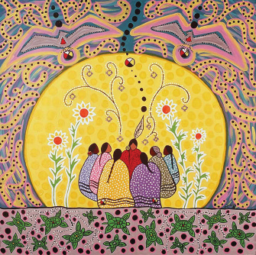
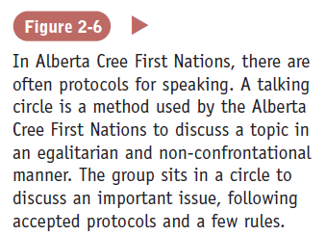

Slide 64
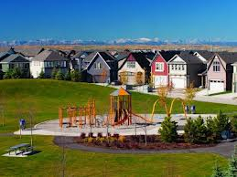
Public Property
Public property is anything—land, buildings, vehicles—not privately owned by individuals. Generally speaking, public property is owned by the state or the community, and managed according to the best interests of the community.

Slide 65
Public Property
Different ideologies support the idea of public property to varying degrees.
In a Communist state (where each member is working for the common benefit), all industries could be public property— controlled by the state for the common good of the collective.

Slide 66
Public Property
According to Karl Marx’s The Communist Manifesto (1848), “the theory of the Communists may be summed up in the single sentence: Abolition of private property.” Marx and thinkers like him argued that only workers should profit from their own labour, not employers or the owners of the companies.
It has been argued that not only is this arrangement fairer for the workers, but it also provides a source of motivation in the absence of financial rewards: because every worker has a stake in the enterprise, they will all have a greater interest in its success.

Slide 67
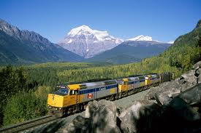
Public Property
The concept of public property is also present to a lesser extent in liberal democracies such as Canada. Parks, schools, roads, libraries, Crown land, and Crown corporations (such as Via Rail or the CBC) are all examples of property that the government manages in the interest of all of society. These properties are maintained with public money raised through taxation.

Slide 68
Collective Interest
Collective interest refers to the set of interests that members of a group have in common.
More specifically, the principle of collective interest states that while individual members may have individual interests, these interests are often better addressed by making them a common set of interests that the group can address together.

Slide 69
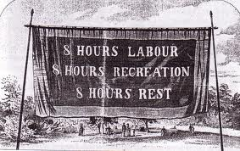
Collective Interest
Collective interest is the basis for the organized labour movement, which began during the Industrial Revolution.
As members of organized trade unions, workers were able to fight successfully for better working conditions and higher rates of pay— successes that individuals could not have realized alone.

Slide 70
Collective Interest
Collective interest is also the foundation for social movements and lobby groups, such as human rights groups, professional groups, or international organizations such as the Assembly of First Nations (AFN).
All of these groups represent people with common interests and goals who come together to press for change and reform.

Slide 71
Collective Responsibility
Collective responsibility means holding the whole group responsible for the actions of individuals (or individual groups) within the group.
Collective responsibility asserts that there is no individual action for which the group cannot in some way be held accountable.
Acknowledgment of collective responsibility is often made in response to deep-rooted social problems that cannot be addressed by targeting individuals or a single group. For example, campaigns against underage drinking often state that the cure for this problem must be a collective responsibility.

Slide 72
Collective Responsibility
On the other hand, the idea of collective responsibility does not always guarantee a caring society.
Sometimes the idea of collective responsibility is used in totalitarian states such as North Korea, where a strong central government has complete control over most aspects of citizens’ lives and does not allow political opposition. In such a society, if one member of a family criticizes the government or its leaders, the whole family might be punished to send a message that the behaviour is not tolerated.

Slide 73
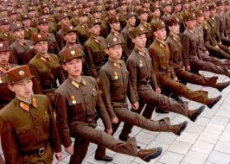
Collective Responsibility
Authoritarian governments in particular often claim to be acting on behalf of the “good of all” even when their actions are punitive.

Slide 74
Adherence to Collective Norms
Groups usually impose norms, or standards, on their members as a condition of membership in the group
These norms can relate to conduct, values, or appearance. While they are voluntary, the group members generally see these standards as binding, which makes adherence to collective norms important.

Slide 75
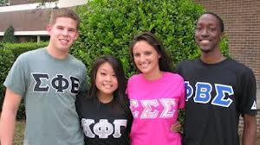
Adherence to Collective Norms
Sororities and fraternities, political parties, faith groups, trade unions, and professional groups all impose certain standards of conduct on their members. Living up to these standards may be considered a daily responsibility

Slide 76
Adherence to Collective Norms
Censorship— deliberately restricting information the public will see—is another example of the imposition of a collective norm.
Many media censor themselves informally; however, some governments impose censorship on media.

